Slide 1
Types of Measurement Errors
By
Candida Nakida Mwisomba

Slide 2
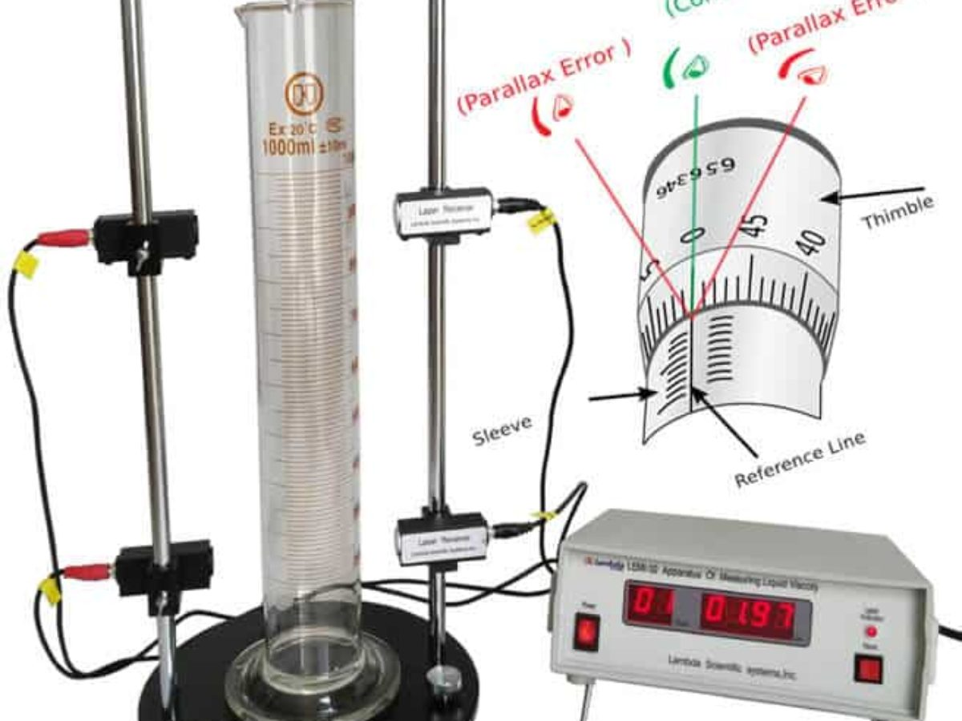
ERROR ANALYSIS

Slide 3
ERRORS
SOURCES OF ERROR
1. Faulty design of instrument
2. Insufficient knowledge of quantity and design conditions.
3. Improper maintenance of the instrument.
4. Sudden change in the parameter to be measured.
5. Unskilled operator.
6. Effects of environmental condition.

Slide 4
ERRORS
TYPES OF ERROR
1. Gross error
2. Systematic error
3. Random error

Slide 5
ERRORS
1. GROSS ERROR: (PERSONAL ERROR)
Occurs due to the carelessness of human while reading, recording and calculating results.
Due to incorrect adjustment of instrument.
To eliminate
Take care while reading, taking and calculating results.
Take 3 or more readings with 3 or more persons.

Slide 6
ERRORS
2. SYSTEMATIC ERROR:
A constant uniform deviation of operation in instrument is known as schematic error.
Due to short comings and characteristics of the material used in instrument like worn parts, ageing effects etc.;
Types:
a) Instrumental error
b) Environmental error
c) Observational error

Slide 7
ERRORS
a) Instrumental error
(i) Shortcoming of instrument: due to mechanical structure of the instrument. e.g. friction of bearings, irregular spring tension, variation in airgap etc.;
To eliminate error:
Select proper instrument and select proper procedure.
Identify effect of errors and correct it.
Calibrate the instrument.

Slide 8
ERRORS
(ii) Misuse of instrument: e.g. poor initial adjustment, improper zero setting, using leads of high resistance.
(iii) Loading effect: e.g. connecting a well calibrated voltmeter across the two points of high resistance circuit.

Slide 9
ERRORS
(b) Environmental error
They are due to:
Temperature changes
Pressure changes
Thermal e.m.f
Stray capacitance
Cross capacitance
To eliminate error:
Proper correction factors given by manufacturer.
Make arrangement to keep surrounding constant like using A.C.
Sealing the component to avoid dust and humidity.
Proving magnetic and electrostatic shield.

Slide 10
ERRORS
(c) Observational error
Errors made by observer. e.g. parallax error while reading meter, wrong scale selection.
To eliminate error:
Use instruments with mirrors
Knife edge pointers.

Slide 11
ERRORS
3. RANDOM ERROR:
Causes of errors which are unknown are regarded as random error.
Due to accumulation of large number of small errors
They can not be corrected by any method
Use statistical methods to obtain best approximation of readings.

Slide 12
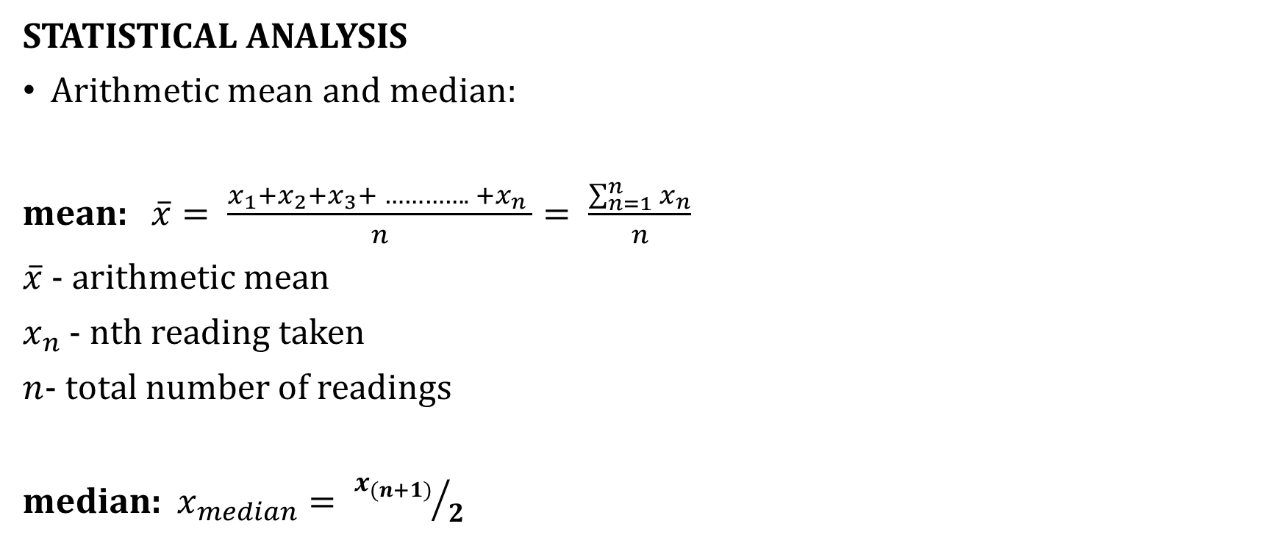
ERROR ANALYSIS
STATISTICAL ANALYSIS
Arithmetic mean and median:
mean: $\overline{x}= \frac{x_{1}+x_{2}+x_{3}+ …………. +x_{n} }{n}= \frac{\sum_{n=1}^{n}{x_{n}}}{n}$
$\overline{x}$ - arithmetic mean
$x_{n}$ - nth reading taken
$n$- total number of readings
median: $x_{median}= {x_{(n+1)}}/2$

Slide 13

ERROR ANALYSIS
Deviation from mean:
$$d_{i}= x_{i} − \overline{x}$$
$d_{i}$-deviation of ith reading
$x_{i}$- value of ith reading
$\overline{x}$- arithmetic mean
Average deviation(mean deviation):
$$\overline{D}= \frac{\sum{\left|d_{i}\right|}}{n}$$

Slide 14

ERROR ANALYSIS
Standard deviation:
$$σ= \sqrt{\frac{d_{1}^{2}+ d_{2}^{2}+ …. + d_{n}^{2}}{n}}= \sqrt{\frac{\sum{d^{2}}}{n}}$$
For reading less than 20 numbers
$$σ= \sqrt{\frac{d_{1}^{2}+ d_{2}^{2}+ …. + d_{n}^{2}}{n−1}} , n<20$$

Slide 15

ERROR ANALYSIS
Variance: mean square deviation
$$V = σ^{2}=\frac{d_{1}^{2}+ d_{2}^{2}+ …. + d_{n}^{2}}{n}$$
For reading less than 20
$$V = σ^{2}=\frac{d_{1}^{2}+ d_{2}^{2}+ …. + d_{n}^{2}}{n−1} , n<20$$

Slide 16
AGGREGATION OF ERRORS
Errors in measurement systems often arise from two or more different sources, and these must be aggregated in the correct way in order to obtain a prediction of the total likely error in output readings from the measurement system.
Two different forms of aggregation are required:
Firstly, a single measurement component may have both systematic and random errors and,
Secondly, a measurement system may consist of several measurement components that each have separate errors.

Slide 17
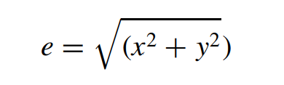
Combined effect of systematic and random errors
If a measurement is affected by both systematic and random errors that are quantified as ±𝑥 (systematic errors) and ±𝑦 (random errors), some means of expressing the combined effect of both types of error is needed:
The likely maximum error will be presented as:

Slide 18
Aggregation of errors from separate measurement system components
All four mathematical operations of addition, subtraction, multiplication and division may be performed on measurements derived from different instruments/transducers in a measurement system.
Appropriate techniques for the various situations that arise are:
Error in a sum
Error in a difference
Error in a product
Error in a quotient

Slide 19
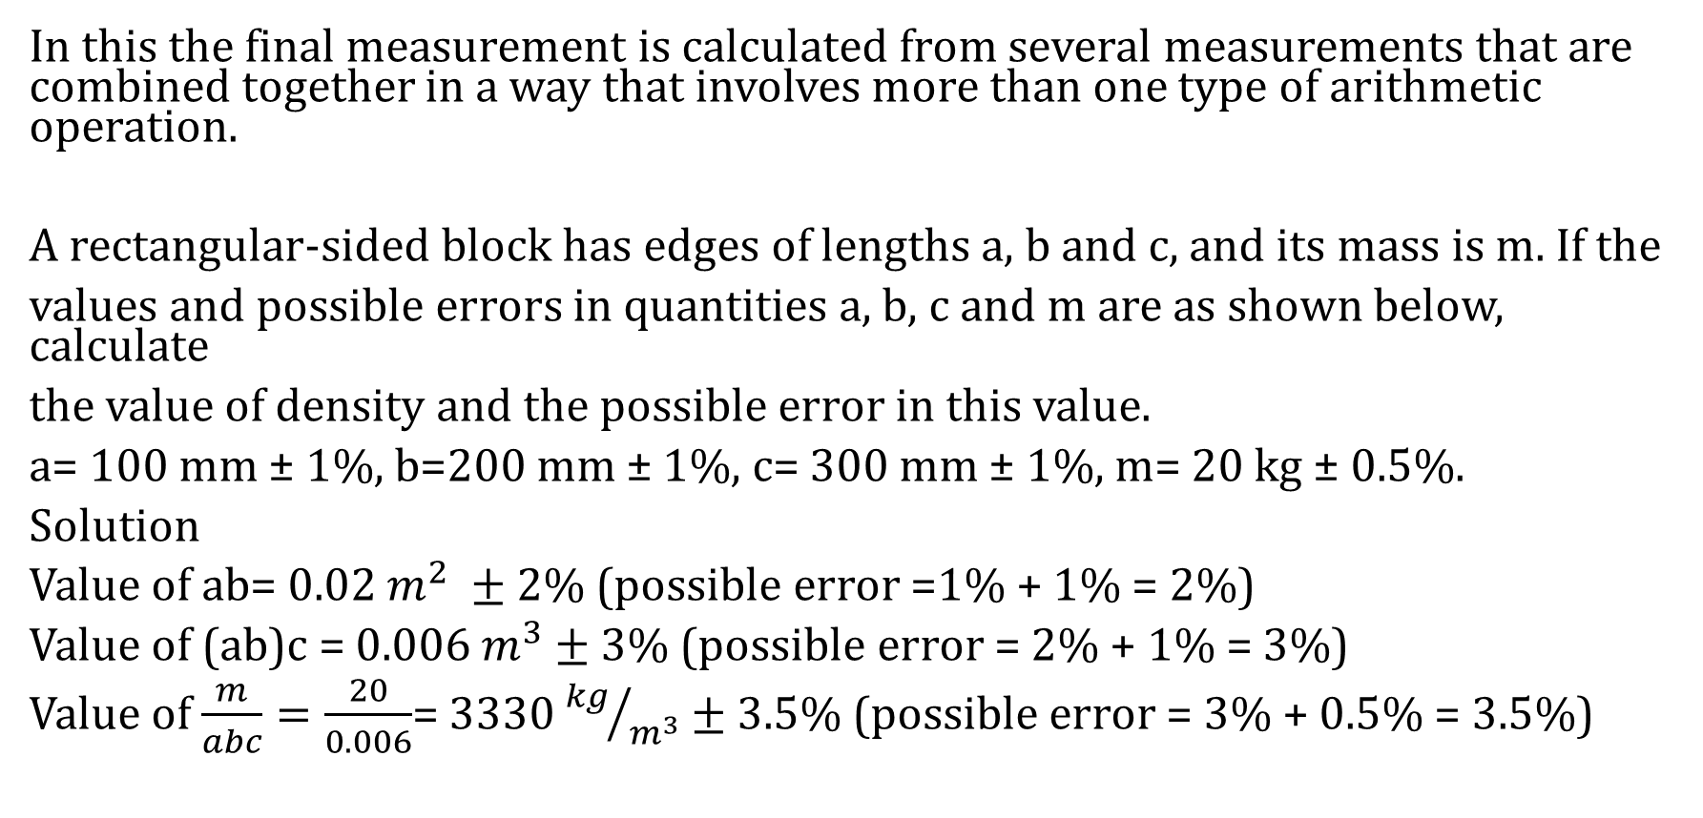
TOTAL ERROR WHEN COMBINING MULTIPLE MEASUREMENT
In this the final measurement is calculated from several measurements that are combined together in a way that involves more than one type of arithmetic operation.
A rectangular-sided block has edges of lengths a, b and c, and its mass is m. If the
values and possible errors in quantities a, b, c and m are as shown below, calculate
the value of density and the possible error in this value.
a= 100 mm ± 1%, b=200 mm ± 1%, c= 300 mm ± 1%, m= 20 kg ± 0.5%.
Solution
Value of ab= 0.02 $m^{2} ±$2% (possible error =1% + 1% = 2%)
Value of (ab)c = 0.006 $m^{3}$ $±$ 3% (possible error = 2% + 1% = 3%)
Value of $\frac{m}{abc}=\frac{20}{0.006}$= 3330 ${kg}/{m^{3}}$ $±$ 3.5% (possible error = 3% + 0.5% = 3.5%)

Slide 20
QUESTIONS
???

